Slide 1
Procedural Map Generation Techniques
Presented by Herbert Wolverson Roguelike Celebration 2020

Slide 2
Who is Herbert Wolverson?
Author of the “Rust Roguelike Tutorial”
Author of upcoming book - Learn Rust: Make 2D Games
Author of Nox Futura and far too many words on r/roguelikedev

Slide 3
Source Code and Slides available at:
https://github.com/thebracket/roguelike-celebration-2020

Slide 4
Introduction
What is Procedural Generation?
How does it fit in with hand-made content?
History of Procedural Generation (more slides)

Slide 5
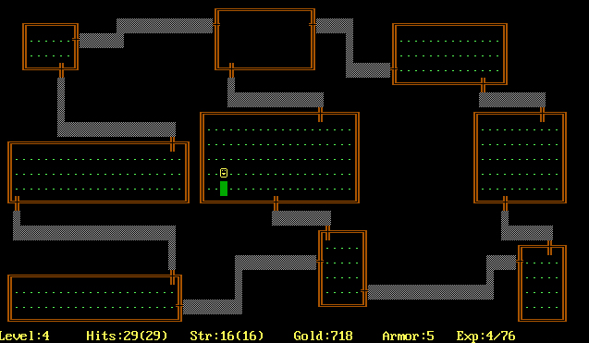
Rogue (1980)

Slide 6
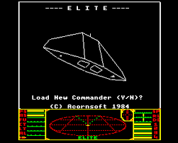
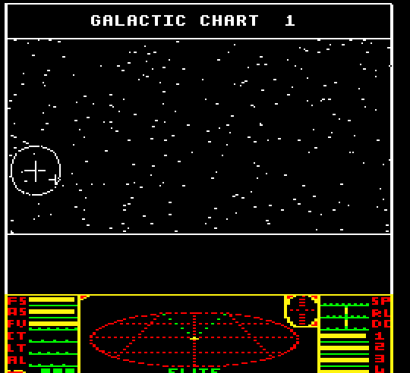
Elite (1984)

Slide 7
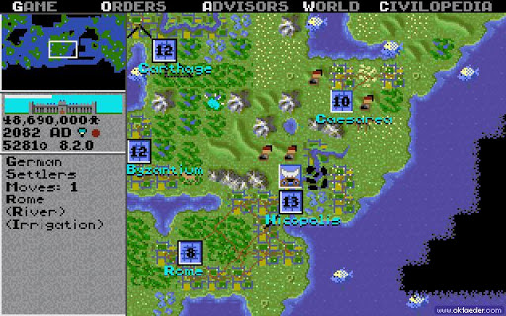
Civilization (1991)

Slide 8
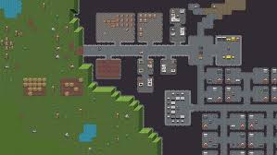
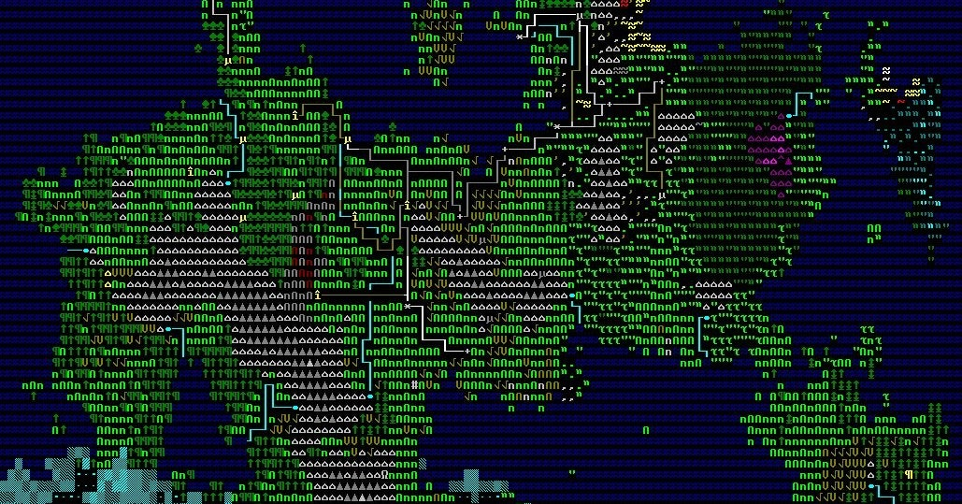
Dwarf Fortress (2006 – Present)

Slide 9
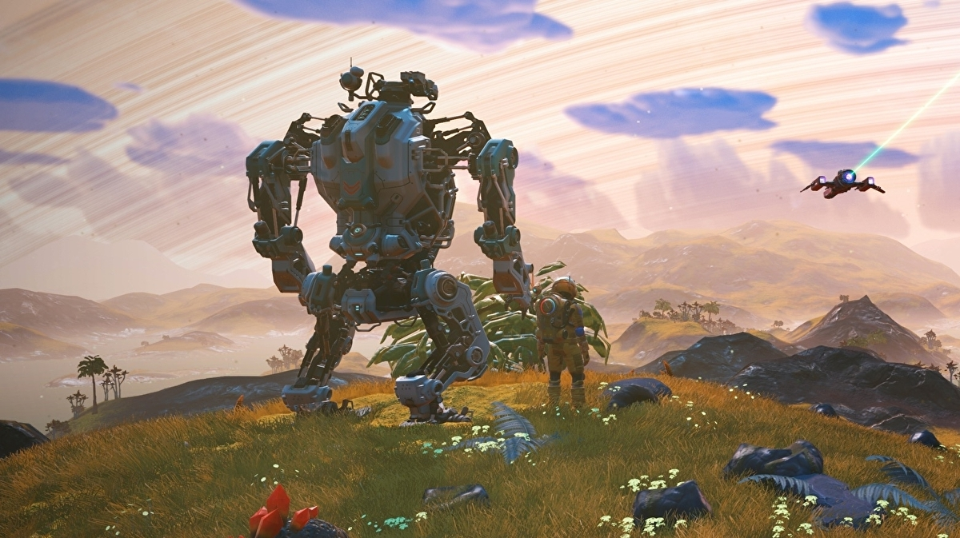
No Man’s Sky (2016 – Present)

Slide 10
PART 1 – Basic Generation Techniques

Slide 11
Simple Room-Based Generation
You’ve probably seen this in Roguelike development tutorials.
Simple algorithm:
Start with a solid map.
Randomly select a room area.
If the room is solid, carve it out and store it in the “rooms” list.
Repeat until you have enough rooms.
Iterate your rooms list, and add dog-leg corridors.

Slide 12
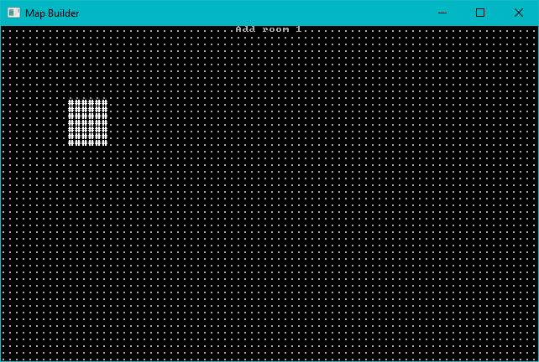
Start with a solid map, add one room at random.

Slide 13
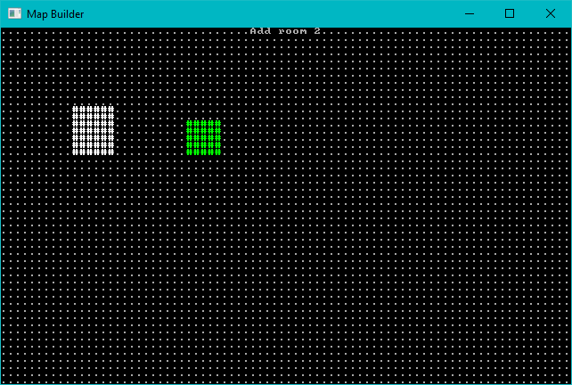
Add a second room

Slide 14
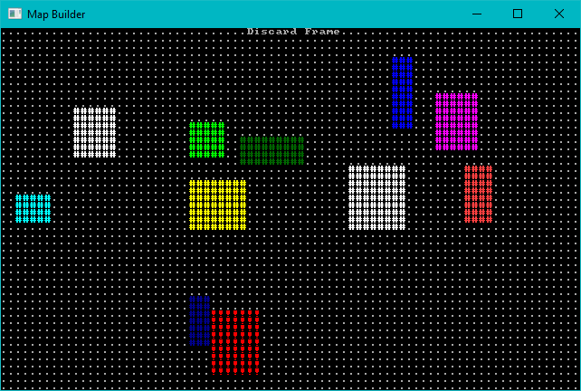
Keep Adding Rooms – Don’t Add Overlapping Ones

Slide 15
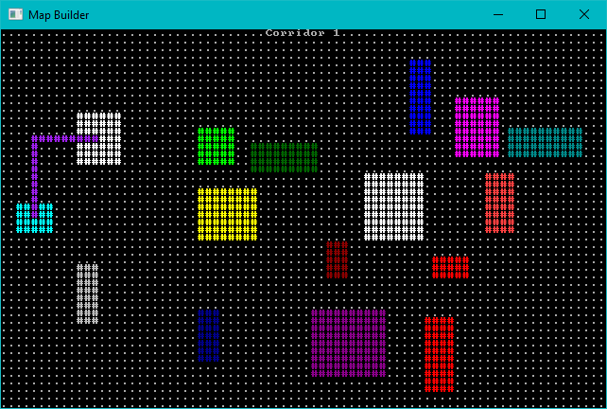
Add Corridors – Dog-leg Style

Slide 16
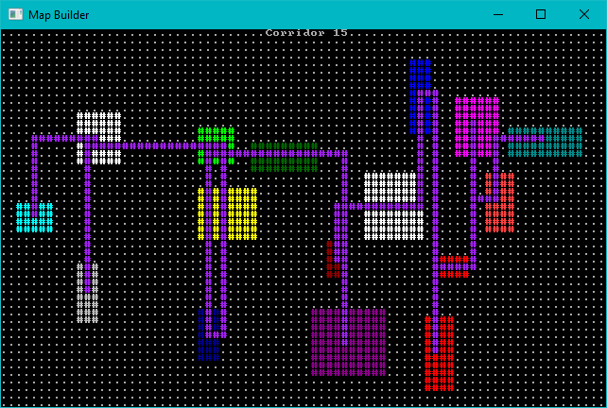
Add More Corridors Until Every Room is Connected

Slide 17
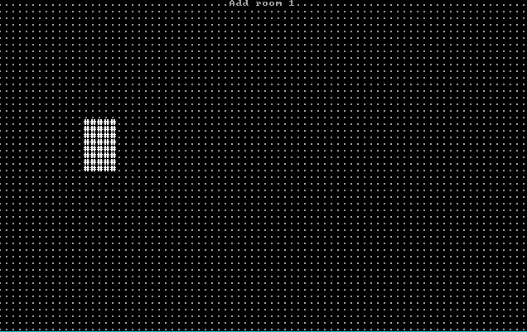
Room Algorithm - Animated

Slide 18
Sub-Divide Room-Based Generation
Nicer room generation. Nethack uses it. (In BSP form)
Divide your map into squares – and divide those squares into squares.
Each sub-square might become a room.
Sort rooms and add corridors.

Slide 19
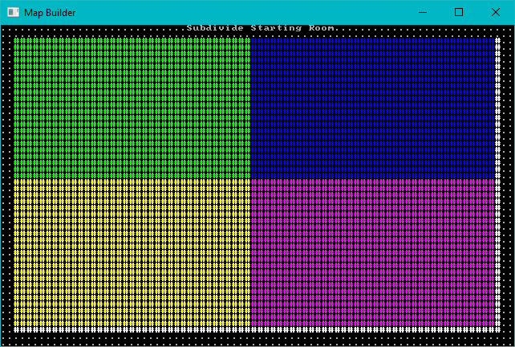
Subdivide the map

Slide 20
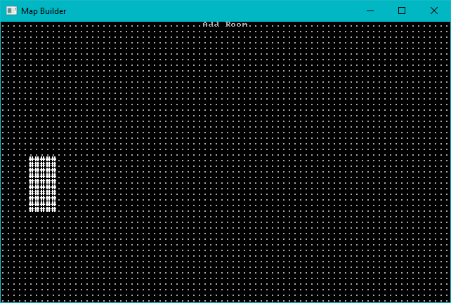
Consider each region. Either divide, or add a room.

Slide 21
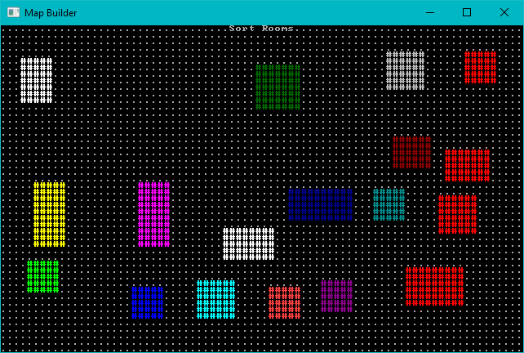
Keep Adding Rooms, Sort by X

Slide 22
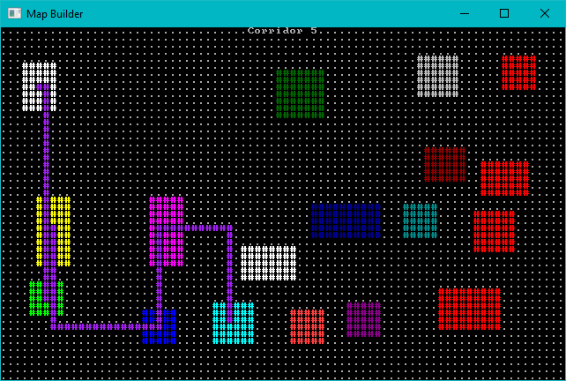
Add Corridors as Before

Slide 23
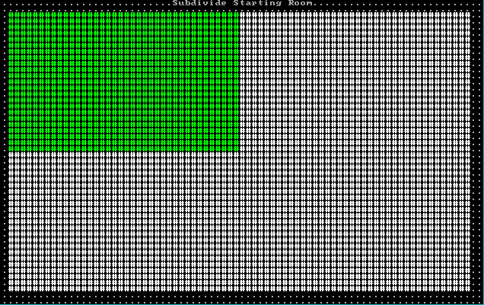
Animated Sub-Division

Slide 24
Cellular Automata
Evolve order from chaos.
Treat each cell as its own entity, make “live” (become a floor) or “die” (become a wall) decisions by counting neighbors.
Great for organic, natural looking maps.

Slide 25
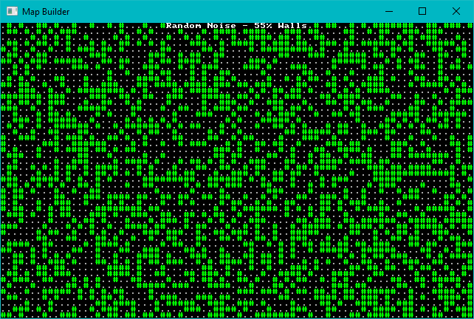
Start with Some Chaos (55% walls)

Slide 26
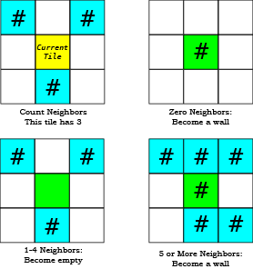
For each tile, count neighbors and decide on its future.

Slide 27
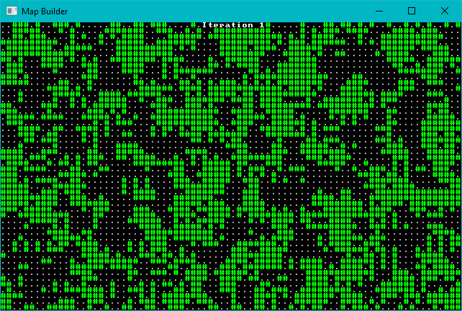
Let each iteration run

Slide 28
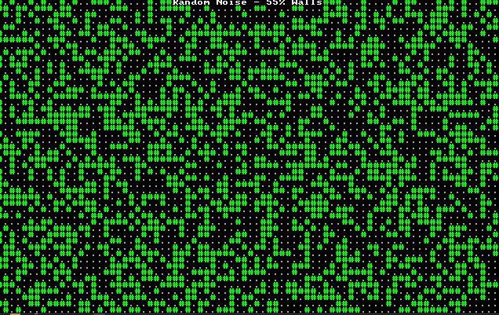
Animated Cellular Automata

Slide 29
Drunkard’s Walk
Give an Umber Hulk an unlimited pot of beer, and see what happens.
Starts with a solid level.
Place a digger, and have them stagger randomly clearing tiles.
Find an open tile, and start a new digger there.
Repeat until you have a sufficiently open map.

Slide 30
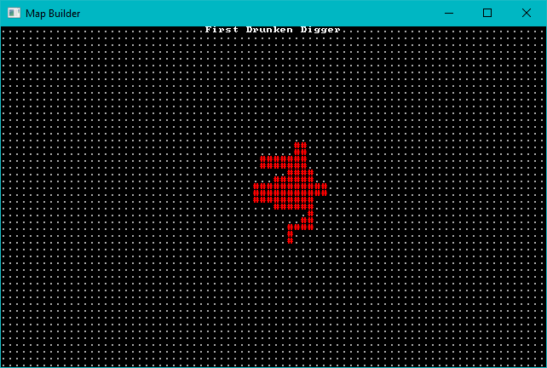
First Random Digger

Slide 31
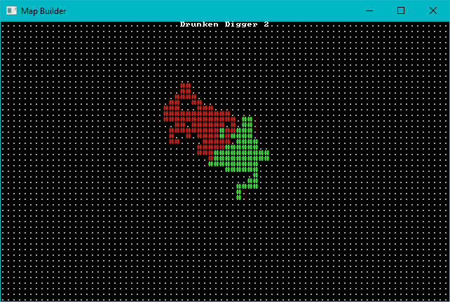
Second Random Digger

Slide 32
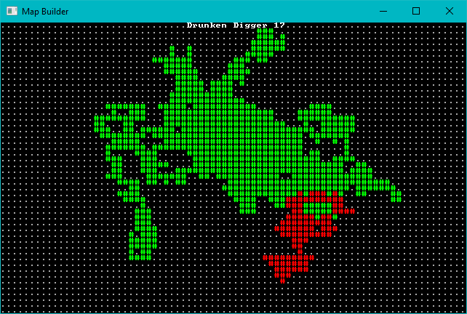
Keep Digging

Slide 33
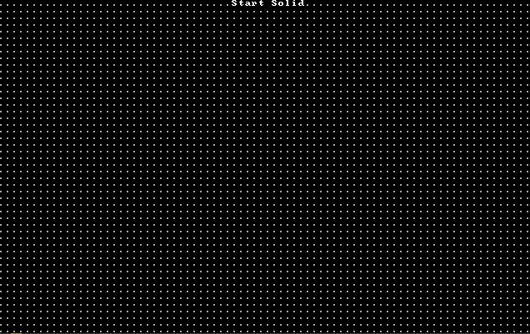
Animated Drunkard’s Walk

Slide 34
Diffusion Limited Aggregation
Similar to Drunkard’s Walk.
Instead of digging from a random mover’s location, you fire a particle from a random point – and carve out the first wall adjacent to a floor that they hit.
Several variations on this theme.

Slide 35
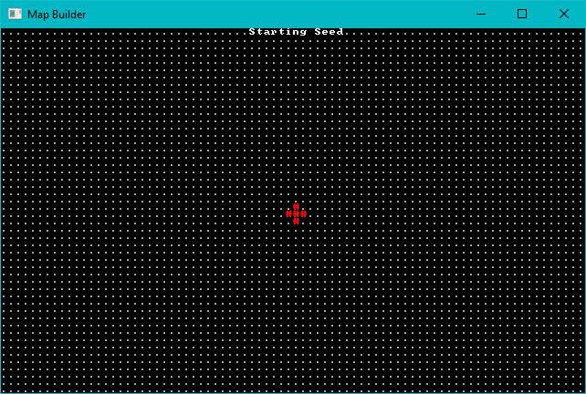
Starting Seed Area

Slide 36
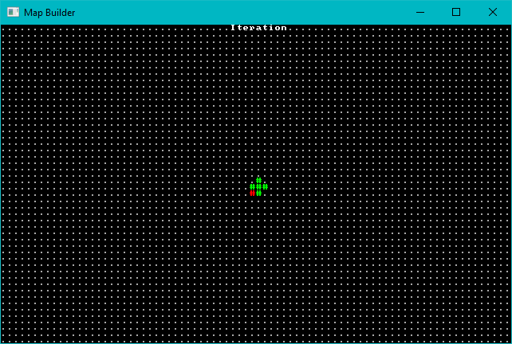
First Particle

Slide 37
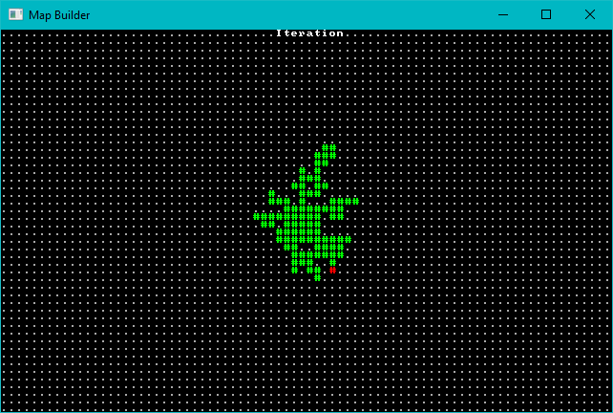
Keep Firing!

Slide 38
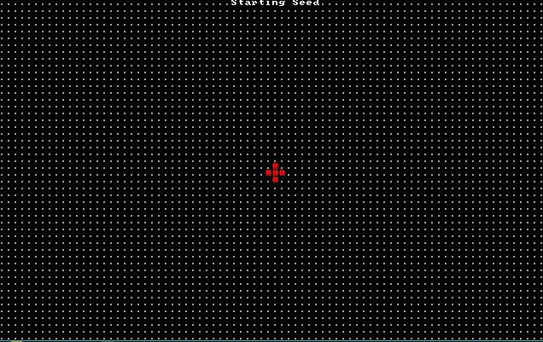
Animated Inwards DLA

Slide 39
DLA Variations
Change how the particle travels.
Outwards: start in the middle and keep going outwards until you hit a wall. Very similar to drunkard’s walk.
Attractor: attract particles towards a point, for an open center with random edges.

Slide 40
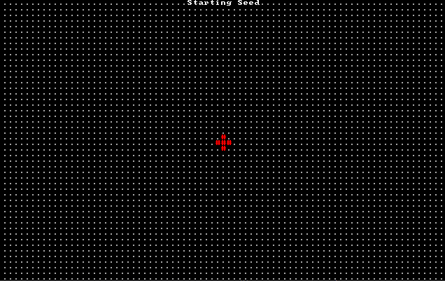
Animated Central Attractor DLA

Slide 41
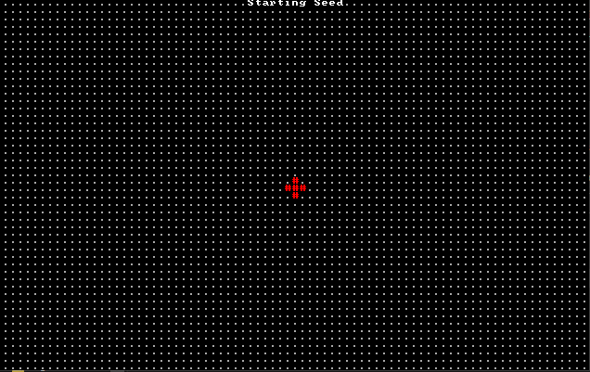
Symmetrical DLA

Slide 42
PART 2 – Meta-Builders
One algorithm isn’t always enough.
You can always run a second algorithm using your first as its input.

Slide 43
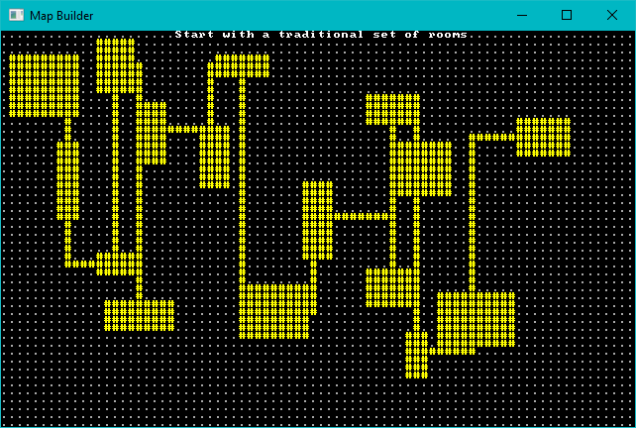
Eroding Maps with DLA

Slide 44

Erosion – Pick a starting point, path randomly until you hit a wall. Dig.

Slide 45
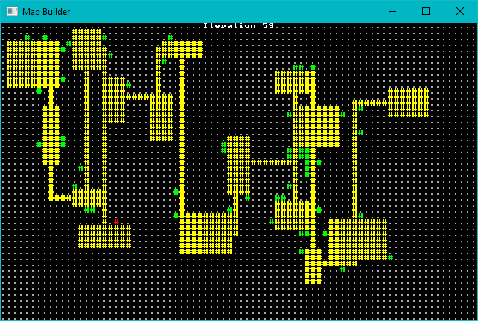
Erosion – Keep Digging!

Slide 46
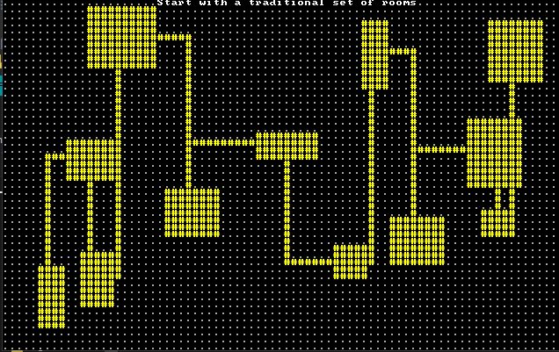
Animated Erosion

Slide 47
Combining Layers
You don’t have to use just one technique on a map.
Transition maps really benefit from layering multiple techniques.

Slide 48
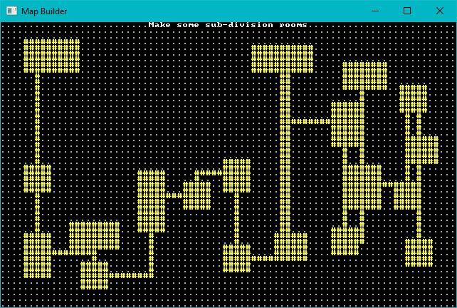
Layers: Start with a Room Map

Slide 49
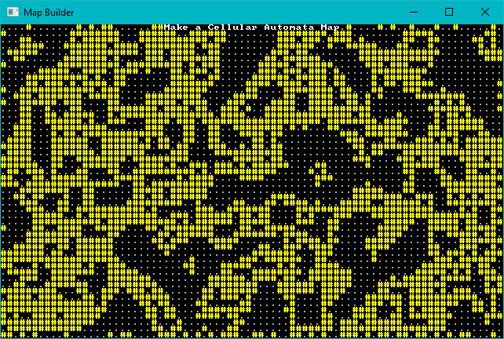
Layers: Make a Cellular Automata Map

Slide 50
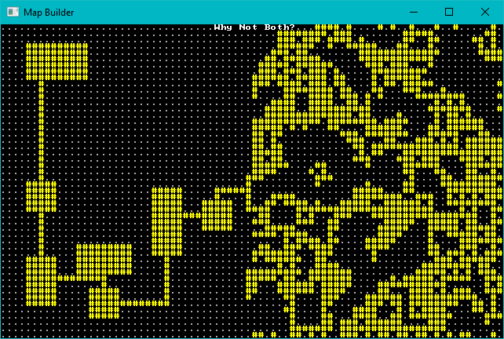
Layers: Add them together

Slide 51
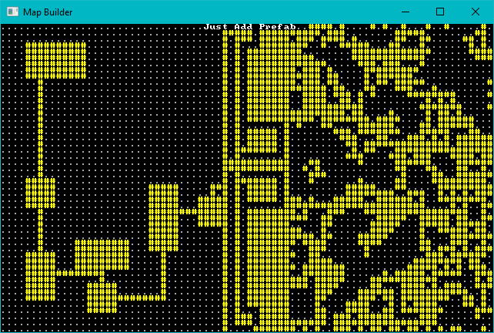
Layers: Extra Fancy with a Prefab

Slide 52
PART 3 – Let’s Make Some Noise
Noise functions are awesome.
We’ll focus on Perlin/Simplex noise.

Slide 53
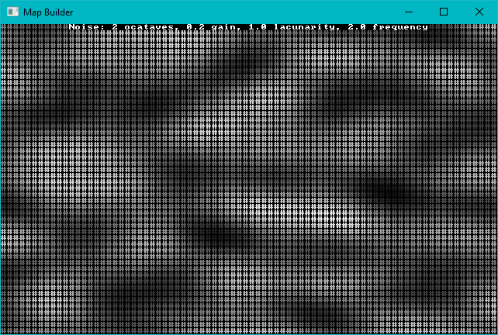
Simple 2D Noise

Slide 54
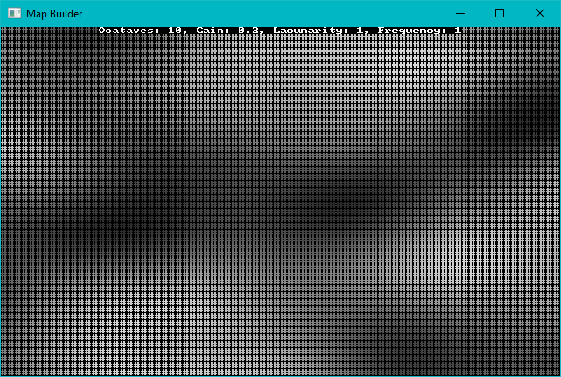
Perlin Octaves
Add Octaves to add more “high” regions.

Slide 55
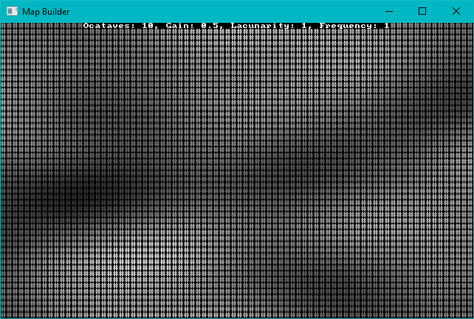
Perlin Gain
Gain makes octaves persist longer.

Slide 56
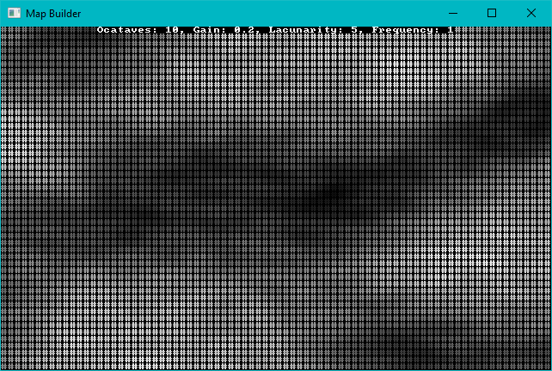
Perlin Lacunarity
Lacunarity adds randomness

Slide 57
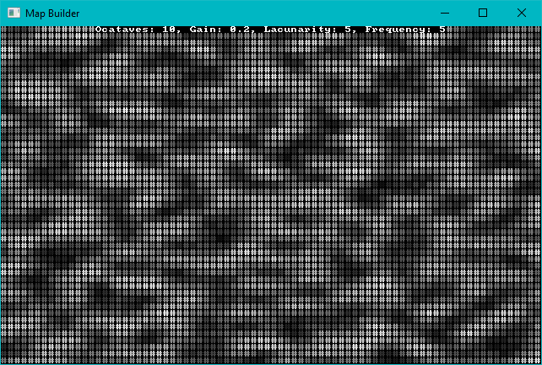
Perlin Frequency
Frequency makes the ridges more common

Slide 58
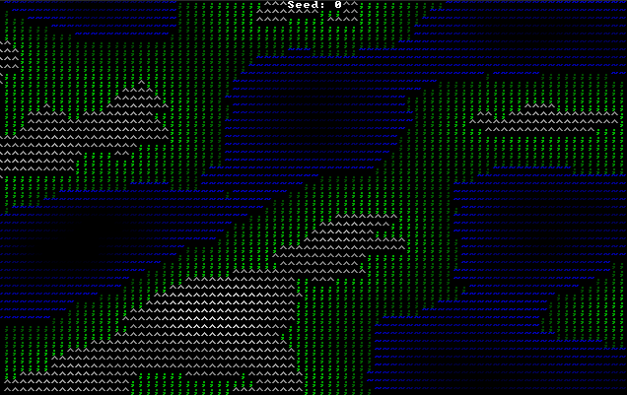
Making an Overworld

Slide 59
Making a Spherical World

Slide 60
Making a 3D Map

Slide 61
PART 4 – Prefabs/Vaults

Slide 62
Wrap-Up

Slide 63
Questions?
Source code: https://github.com/thebracket/roguelike-celebration-2020
I wrote a book:
Learn Rust: Build 2D Games Available soon from PragProg.com

